Slide 1
Modeling the Iowa Gambling Task

Slide 2
Today’s goals
Expanding your theoretical toolbox for modeling learning and decisions
Work with some more complicated models
Consolidate you skills in reading and understanding modeling papers

Slide 3
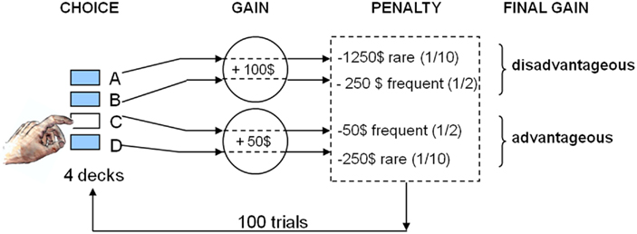
Iowa Gambling Task – Learning and Choice
Bechara, Damasio, Damasio, & Anderson, 1994

Slide 4
Why the Iowa Gambling Task is interesting
Reduced performance after damage to OFC
Reduced performance associated with addiction
Reduced performance in Huntington’s (not Parkinson’s)
Reduced performance in psychopathy

Slide 5
RL models of the IGT
A
B
C
D
Red = negative valence
Blue = positive valence
Shade = strength
Central concept – We choose a deck based on our expected valence for all decks
Learning model – We update expected valence by choosing and getting feedback
……variations on standard bandit models of choice

Slide 6
Available IGT models
EVL – Busemeyer & Stout, 2002
PVL and related – e.g. Steingroever, Wetzels, & Wagenmakers, 2013
ORL – Haines, Vassileva, & Ahn, 2018
VSE – Ligneul, 2019
Also IBLT versions – Gonzales et al

Slide 7
Module focus
PVL-delta – Steingroever, Wetzels, & Wagenmakers, 2013
Prospect theory
ORL – Haines, Vassileva, & Ahn, 2018
Outcome frequency and choice perseverance
Application to gambling research
VSE – Ligneul, 2019
Exploration

Slide 8
Module focus
PVL-delta – Steingroever, Wetzels, & Wagenmakers, 2013
Prospect theory
ORL – Haines, Vassileva, & Ahn, 2018
Outcome frequency and choice perseverance
Application to gambling research
VSE – Ligneul, 2019
Exploration

Slide 9
Prospect theory

Slide 10

Utility functions
Awesomeness
EV Theory Assumption:
Subjective Value = Objective value
EU Theory Assumption:
Subjective Value = f(Objective value)
Utility
Value

Slide 11
Utility functions
Pretty good
EV Theory Assumption:
Subjective Value = Objective value
EU Theory Assumption:
Subjective Value = f(Objective value)
Utility
Value

Slide 12
Utility functions
Feeling a bit sick
EV Theory Assumption:
Subjective Value = Objective value
EU Theory Assumption:
Subjective Value = f(Objective value)
Utility
Value

Slide 13
How do utility funcitons determine risk preferences?

Slide 14
Risk preferences and the coin toss
500kr for sure, or a 50% chance to receive 1000kr

Slide 15
Risk preferences
Preferences toward the coin toss
Risk neutral: don’t care
Risk averse: 500kr
Risk seeking: coin toss
Generally
A person is risk averse if they would prefer a certain payment of equal value to the expected utility of a lottery, over the expected utility of that value itself.

Slide 16
Risk Aversion
Expected value of the lottery
PA*VA + PB*VB
= (.5*0) + (.5*1000)
= 500
1000
Subjective Value
500
0
500
1000
Objective Value

Slide 17
Risk Seeking
Expected value of the lottery
PA*VA + PB*VB
= (.5*0) + (.5*1000)
= 500
20
Subjective Value
10
0
500
1000
Objective Value

Slide 18
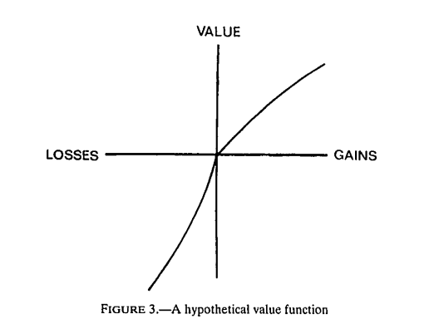
Prospect Theory Value Function
Concave for gains
Axis: Gains or losses around a reference point – avoids asset integration
Convex for losses
Also Steeper for losses
More risk seeking for losses, than risk averse for gains

Slide 19
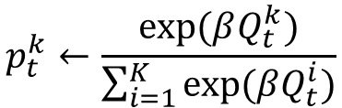


Revision: Bandit model
Q^{k}_{t-1}
a
Q^{k}_{t}
r_{t-1}
$$Q_{t}^{k}←Q_{t−1}^{k}+a(r−Q_{t−1}^{k})$$
β
p^{k}_{t}
$$p_{t}^{k}←\frac{exp⁡(βQ_{t}^{k})}{\sum_{i=1}^{K}{exp⁡(βQ_{t}^{i})}}$$
k options
k_{t}
$$k_{t}\sim Categorical(p_{t})$$
t trials

Slide 20
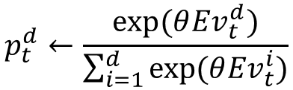

Luce choice
Ev^{d}_{t}
Expected utility of deck d, on trial t
θ
p^{k}_{t}
$$p_{t}^{d}←\frac{exp⁡(θ{Ev}_{t}^{d})}{\sum_{i=1}^{d}{exp⁡(θ{Ev}_{t}^{i})}}$$
Probability of choosing deck d, on trial t
d decks
x_{t}
Choice on trial t (from decks 1 to d)
$$d_{t}\sim Categorical(p_{t})$$
t trials

Slide 21
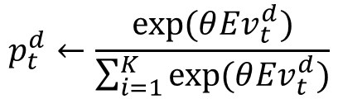

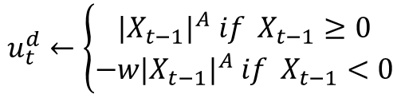

Delta rule + Prospect Theory
X_{t-1}
Ev^{d}_{t-1}
$$u_{t}^{d}←\left\{\begin{aligned}{{|X}_{t−1}|}^{A} if{ X}_{t−1}≥0 \\ {{−w|X}_{t−1}|}^{A} if{ X}_{t−1}<0\end{aligned}\right.$$
A
a
Ev^{d}_{t}
u^{d}_{t}
w
$${Ev}_{t}^{d}←{Ev}_{t−1}^{d}+a(u_{t}^{d}−{Ev}_{t−1}^{d})$$
θ
p^{d}_{t}
$$p_{t}^{d}←\frac{exp⁡(θ{Ev}_{t}^{d})}{\sum_{i=1}^{K}{exp⁡(θ{Ev}_{t}^{d})}}$$
d decks
x_{t}
$$d_{t}\sim Categorical(p_{t})$$
t trials

Slide 22
Module focus
PVL-delta – Steingroever, Wetzels, & Wagenmakers, 2013
Prospect theory
ORL – Haines, Vassileva, & Ahn, 2018
Outcome frequency and choice perseverance
Application to gambling research
VSE – Ligneul, 2019
Exploration

Slide 23
Example from our own research

Slide 24
Problem gambling (in Denmark & Europe)
DK population 5.8 million
10,000 diagnosed with gambling addiction
125,000 some problems with gambling
Estimated 12% of European youth meet criteria for problem gambling
Increasing access and popularization in culture
Low rate of treatment seeking – 10% - 20%

Slide 25
Problem gambling (in Denmark & Europe)
DK population 5.8 million
10,000 diagnosed with gambling addiction
125,000 some problems with gambling
Estimated 12% of European youth meet criteria for problem gambling
Increasing access and popularization in culture
Low rate of treatment seeking – 10% - 20%

Slide 26
Need for early identification and treatment
Prior to onset of major financial problems
Prior to onset of mental health problems (depression and anxiety)
Prior to degradation of social network and hobbies
Problem gambling associated with an increased risk of suicide
Gambling industry: Problem gamblers are bad customers

Slide 27
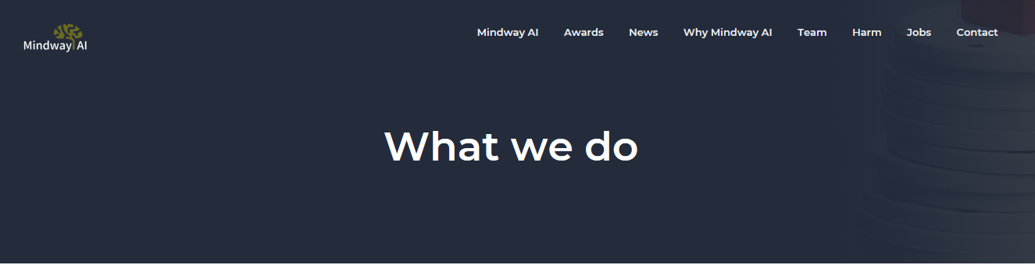
Develop commercial software for early identification of problem gambling
Integrate software within gambling providers’ online and casino environments
Work with agencies responsible for intervention – identify targets for intervention, and inform call scripts

Slide 28
Present Research (& Applications)
Use cognitive modeling of decision making to identify – and maybe even segment – different types of at risk/problem gambler
Mindway Application I: use inferences from decision models for early detection of at-risk gamblers
Mindway Application II: use inferences from decision models to differentiate types of problem gamblers, for the purpose of allocating different approaches in interventions (will say more)

Slide 29
Present Research
Casual gamblers – convenience sample
Clean measure of lifestyle problems linked to gambling
Clean decision task and cognitive model for probing individual differences
Heirarchical model relating 2 and 3

Slide 30
Recruitment
147 people recruited from lab subject pool
Responding to ad calling for people with recent gambling activity
Screened out: no gambling in last 3 months
Screened out: zero on problem gambling questionnaire (GamTest – will say more)
140 data sets

Slide 31
Participant data
Gender: 98 men, 41 women, 1 other
Age: 71 aged 18-22, 56 aged 23-27, rest older
Gambling frequency | Count
Less than once/month | 38
At least once/month | 45
Once/week | 29
2-3 times/week | 17
4-5 times/week | 6
6-7 times/week | 4

Slide 32
Present Research
Casual gamblers – convenience sample
Clean measure of lifestyle problems linked to gambling
Clean decision task and cognitive model for probing individual differences
Heirarchical model relating 2 and 3

Slide 33
GamTest
Self report questionnaire – gambling problems
15 questions – 11 point Likert scale
Clinically and psychometrically validated (Jonsson et al, 2017)
Constructed bottom-up using exploratory factor analysis….
….very messy scoring system

Slide 34
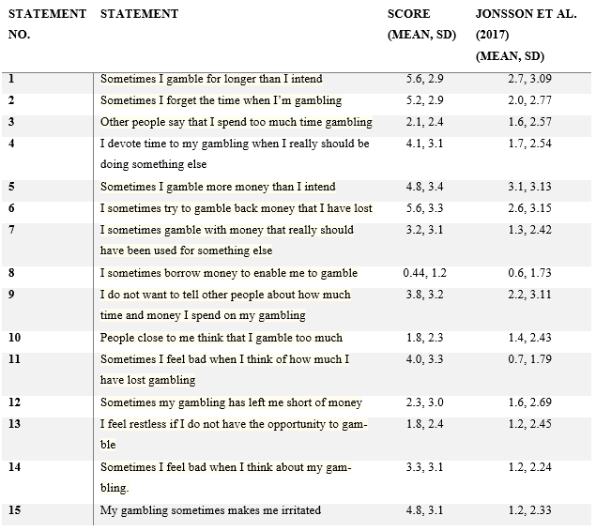

Slide 35
Bi-factor model
General emotional problems factor – all 15 questions
Four sub-factors – varying number of questions
Overconsumption of time
Overconsumption of money
Negative consequences from overconsumption of money
Negative consequences on social life and relationships

Slide 36
Present Research
Casual gamblers – convenience sample
Clean measure of lifestyle problems linked to gambling
Clean decision task and cognitive model for probing individual differences
Heirarchical model relating 2 and 3

Slide 37
Iowa Gambling Task – Learning and Choice
Bechara, Damasio, Damasio, & Anderson, 1994

Slide 38
Available IGT models
EVL – Busemeyer & Stout, 2002
PVL and related – e.g. Steingroever, Wetzels, & Wagenmakers, 2013
ORL – Haines, Vassileva, & Ahn, 2018
VSE – Ligneul, 2019
Also IBLT versions – Gonzales et al

Slide 39
ORL model
Good model recovery
Good parameter recovery
Useful psychological interpretation of parameters

Slide 40

Value learning model
$${EV}_{j}(t)=\left\{\begin{aligned}{EV}_{j}\left(t−1\right)+a_{pun}(x\left(t\right) − {EV}_{j}(t−1)), x<0 \\ &{EV}_{j}\left(t−1\right)+a_{rew}(x\left(t\right) − {EV}_{j}(t−1)), x≥0\end{aligned}\right.$$
Old expected value
Prediction error
Separate learning rates for losses and gains
A
B
C
D
Red = negative valence
Blue = positive valence
Shade = strength

Slide 41
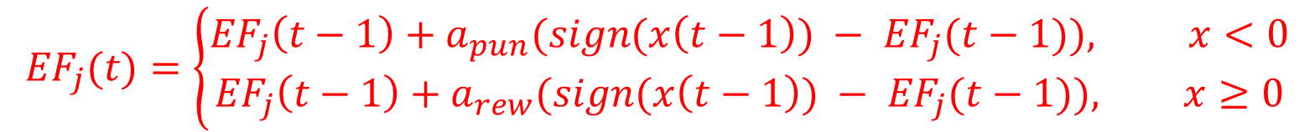

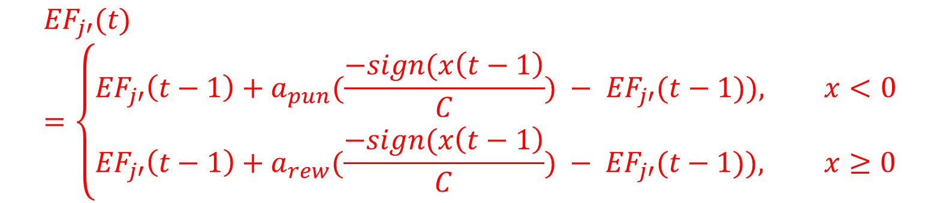
Value learning model
$${EV}_{j}(t)=\left\{\begin{aligned}{EV}_{j}\left(t−1\right)+a_{pun}(x\left(t\right) − {EV}_{j}(t−1)), x<0 \\ &{EV}_{j}\left(t−1\right)+a_{rew}(x\left(t\right) − {EV}_{j}(t−1)), x≥0\end{aligned}\right.$$
Frequency learning model
$${EF}_{j}(t)=\left\{\begin{aligned}{EF}_{j}\left(t−1\right)+a_{pun}(sign(x\left(t−1\right)) − {EF}_{j}(t−1)), x<0 \\ &{EF}_{j}\left(t−1\right)+a_{rew}(sign(x\left(t−1\right)) − {EF}_{j}(t−1)), x≥0\end{aligned}\right.$$
Unchosen decks: reversal learning
C = number of alternatives
$${EF}_{j′}(t)=\left\{\begin{aligned}{EF}_{j′}\left(t−1\right)+a_{pun}(\frac{−sign(x\left(t−1\right)}{C}) − {EF}_{j′}(t−1)), x<0 \\ &{EF}_{j′}\left(t−1\right)+a_{rew}(\frac{−sign(x\left(t−1\right)}{C}) − {EF}_{j′}(t−1)), x≥0\end{aligned}\right.$$
Perseverance model
$${PS}_{j}(t)=\left\{\begin{aligned}\frac{1}{1+K}, chosen decks \\ &{\begin{aligned} \\ \frac{{PS}_{j}\left(t−1\right)}{1+K}\end{aligned}}_{}, unchosen decks\end{aligned}\right.$$
K = decay

Slide 42

Valence model
$$V_{j}\left(t\right)={EV}_{j}\left(t\right)+{EF}_{j}\left(t\right)∗ω_{F}+{PS}_{j}\left(t\right)∗ω_{P}$$
Choice model
$$P(D\left(t\right))=\frac{e^{θ V_{j}\left(t\right)}}{\sum_{k=1}^{4}{e^{θ V_{k}\left(t\right)}}}$$
Parameters of interest
a_{pun} – learning rate for punishments
a_{rew} – learning rate for rewards
ω_{F} – influence of win/loss frequency on valence (relative to value)
ω_{P} – influence of perseverance on valence (relative to value)

Slide 43
Present Research
Casual gamblers – convenience sample
Clean measure of lifestyle problems linked to gambling
Clean decision task and cognitive model for probing individual differences
Heirarchical model relating 2 and 3

Slide 44
GamTest Scores
Exploratory factor analysis – weird scoring
All scores re-scaled scaled to 0-1
5 GamTest scores – 5 sub-factors

Slide 45
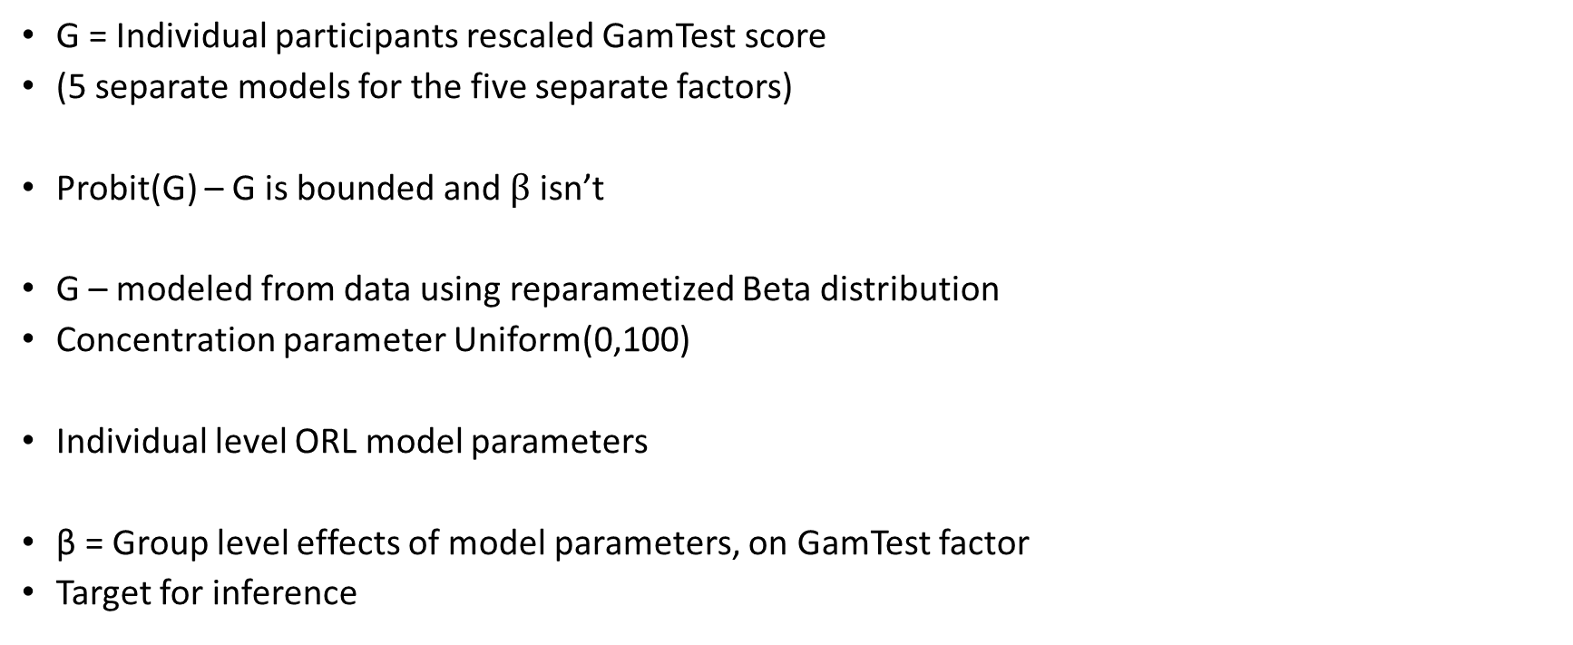
Heirarchical model
$$Probit\left(G\right)=β_{0}+{β_{1}a_{rew}+β_{2}a_{pun}+β_{3}ω_{f}+β_{1}ω_{p}+β_{5}K}_{}$$
G = Individual participants rescaled GamTest score
(5 separate models for the five separate factors)
Probit(G) – G is bounded and $β$ isn’t
G – modeled from data using reparametized Beta distribution
Concentration parameter Uniform(0,100)
Individual level ORL model parameters
β = Group level effects of model parameters, on GamTest factor
Target for inference

Slide 46
Priors
a_{pun} – Uniform(0,1)
a_{rew} – Uniform(0,1)
ω_{F} – Gaussian(0,1)
ω_{P} – Gaussian(0,1)
K – Uniform(0,5)
β – Gaussian(0,0.01)

Slide 47
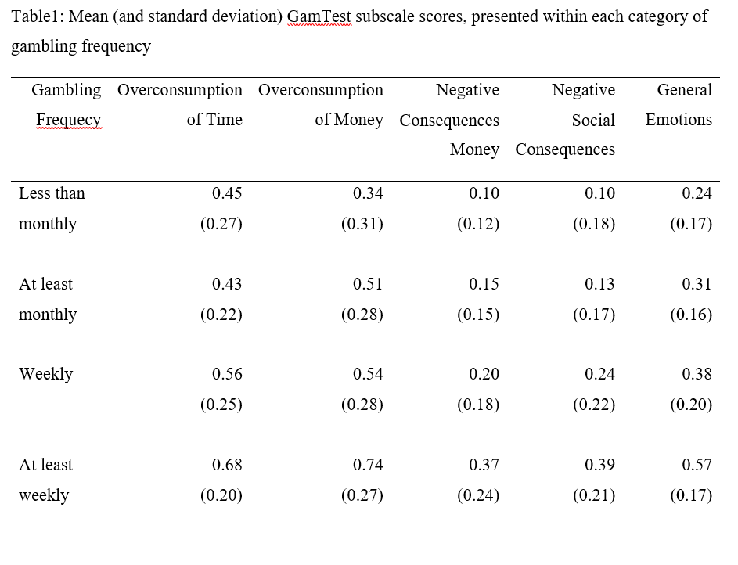
GamTest Results
Reasonable variance – individual difference
Scores increase with gambling frequency

Slide 48
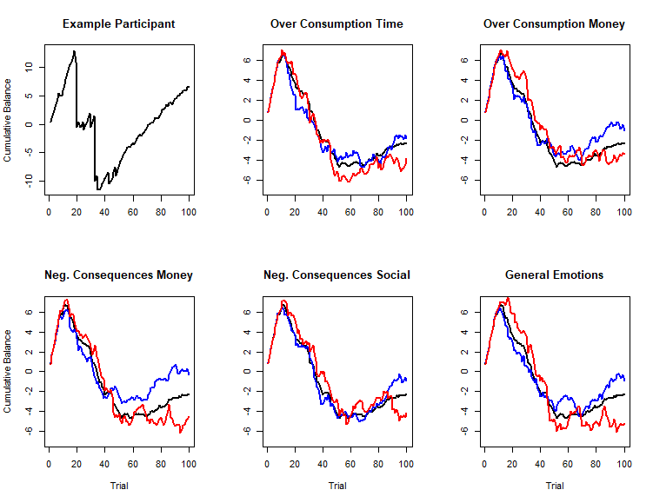
IGT trends
Upper GamTest Quartile
Lower GamTest Quartile

Slide 49
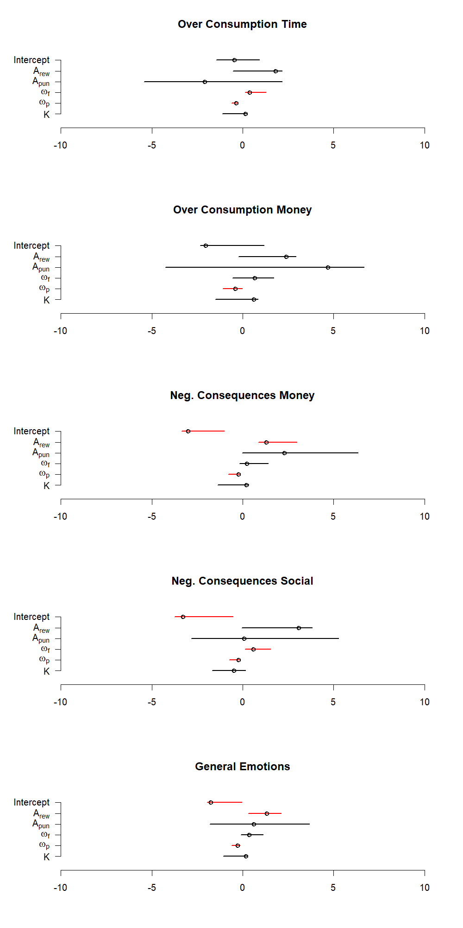
Points = MAP
Lines = 95% Credible Intervals
No overlap with 0

Slide 50
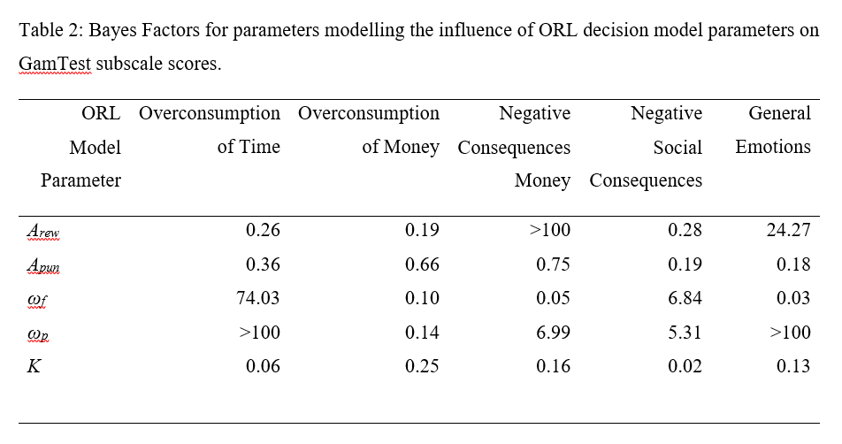
Bayes Factors for β

Slide 51
Two decision profiles?
Increased reward driven learning test
Problems caused by money loss
General emotional problems
Increased sensitivity of choice to reward frequency
Use more time than desired
Social and relational problems

Slide 52
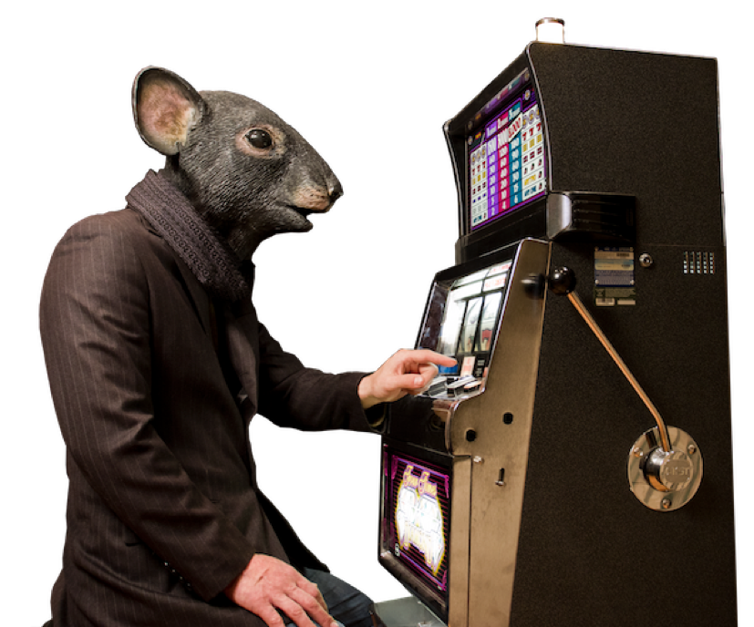
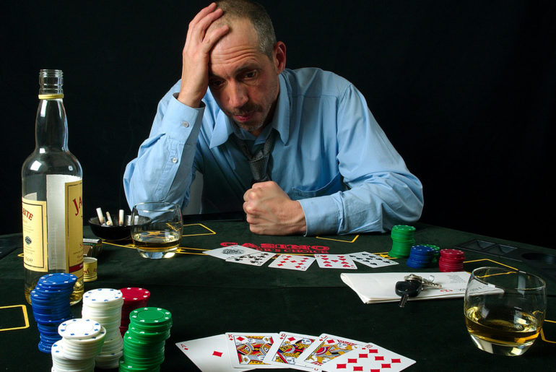
Two types of pathological gambler?

Slide 53
Two types of call script
Hi there we noticed you’ve had some big losses lately and we want to see if you’re feeling okay. To speak to a counsellor call…..
Hi there we’ve noticed you’ve been spending a lot of time at the casino recently. To speak to a counsellor call….

Slide 54
Homework
Draw the plate notation for a single subject implementation of the ORL model

Slide 55
Module focus
PVL-delta – Steingroever, Wetzels, & Wagenmakers, 2013
Prospect theory
ORL – Haines, Vassileva, & Ahn, 2018
Outcome frequency and choice perseverance
Application to gambling research
VSE – Ligneul, 2019
Exploration

Slide 56
Luce choice
How do we model exploration within the Luce choice rule?
VSE – not just “random “exploration (i.e. inverse heat)
Also sequential exploration – learning rule
Ev^{d}_{t}
Expected utility of deck d, on trial t
θ
p^{k}_{t}
$$p_{t}^{d}←\frac{exp⁡(θ{Ev}_{t}^{d})}{\sum_{i=1}^{d}{exp⁡(θ{Ev}_{t}^{i})}}$$
Probability of choosing deck d, on trial t
d decks
x_{t}
Choice on trial t (from decks 1 to d)
$$d_{t}\sim Categorical(p_{t})$$
t trials

Slide 57
Building the model

Slide 58

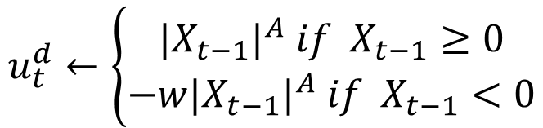
VSE – Utility function - Symmetric
$$u_{t}^{d}←\left\{\begin{aligned}{{|X}_{t−1}|}^{A} if{ X}_{t−1}≥0 \\ {{−w|X}_{t−1}|}^{A} if{ X}_{t−1}<0\end{aligned}\right.$$
$$v\left(t\right)←{Gain(t−1)}^{θ}−{Loss(t−1)}^{θ}$$

Slide 59
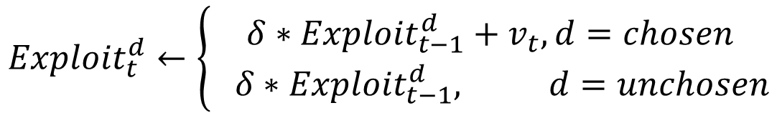


VSE – Value updating – decay process
$${Ev}_{t}^{d}←{Ev}_{t−1}^{d}+a(u_{t}^{d}−{Ev}_{t−1}^{d})$$
$${Exploit}_{t}^{d}←\left\{\begin{aligned}{δ∗Exploit}_{t−1}^{d}+v_{t}, d=chosen \\ { δ∗Exploit}_{t−1}^{d}, d=unchosen\end{aligned}\right.$$
$$δ \sim Uniform(0,1)$$

Slide 60
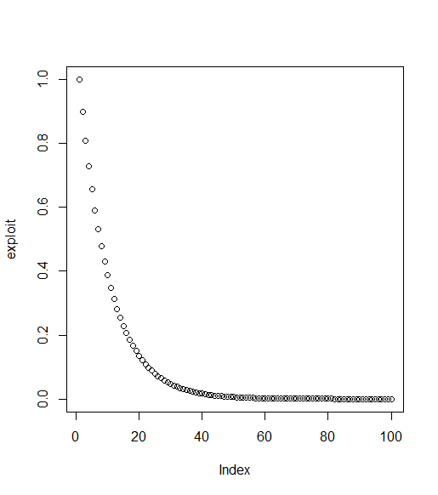
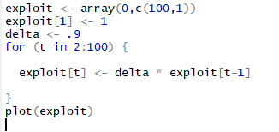
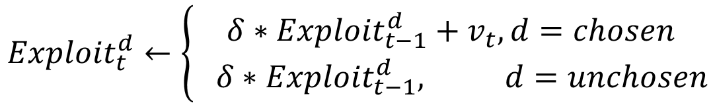
If a deck was never chosen…..
$${Exploit}_{t}^{d}←\left\{\begin{aligned}{δ∗Exploit}_{t−1}^{d}+v_{t}, d=chosen \\ { δ∗Exploit}_{t−1}^{d}, d=unchosen\end{aligned}\right.$$

Slide 61
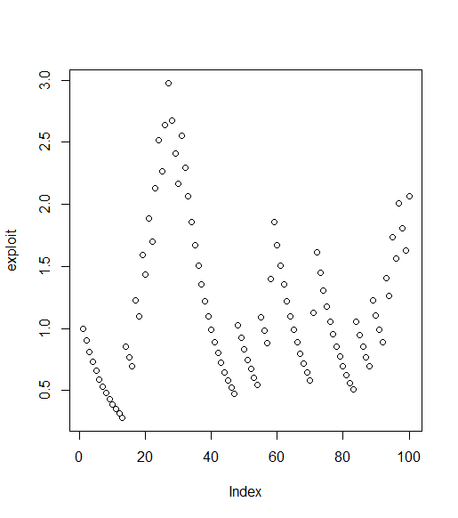
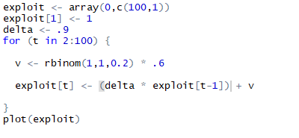
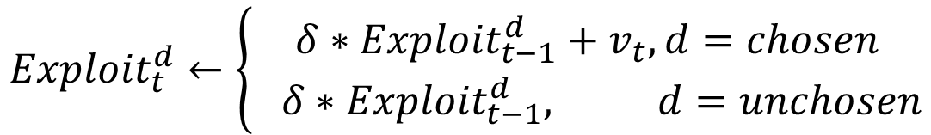
If a deck was chosen at a rate of e.g. 20% (with a value of .6)
$${Exploit}_{t}^{d}←\left\{\begin{aligned}{δ∗Exploit}_{t−1}^{d}+v_{t}, d=chosen \\ { δ∗Exploit}_{t−1}^{d}, d=unchosen\end{aligned}\right.$$

Slide 62
VSE – Sequential exploration
Psychological assumption: people have an “impulse” or “urge” to choose decks they haven’t chosen for a while
Exploration “urge” is modeled like Rescorla-Wagner associative strength
This is affected by three factors
Time since last selection - t
Rate that the “urge” builds up -
Maximum possible “urge” (think maximum associative strength in RW)
(Can be negative!)

Slide 63

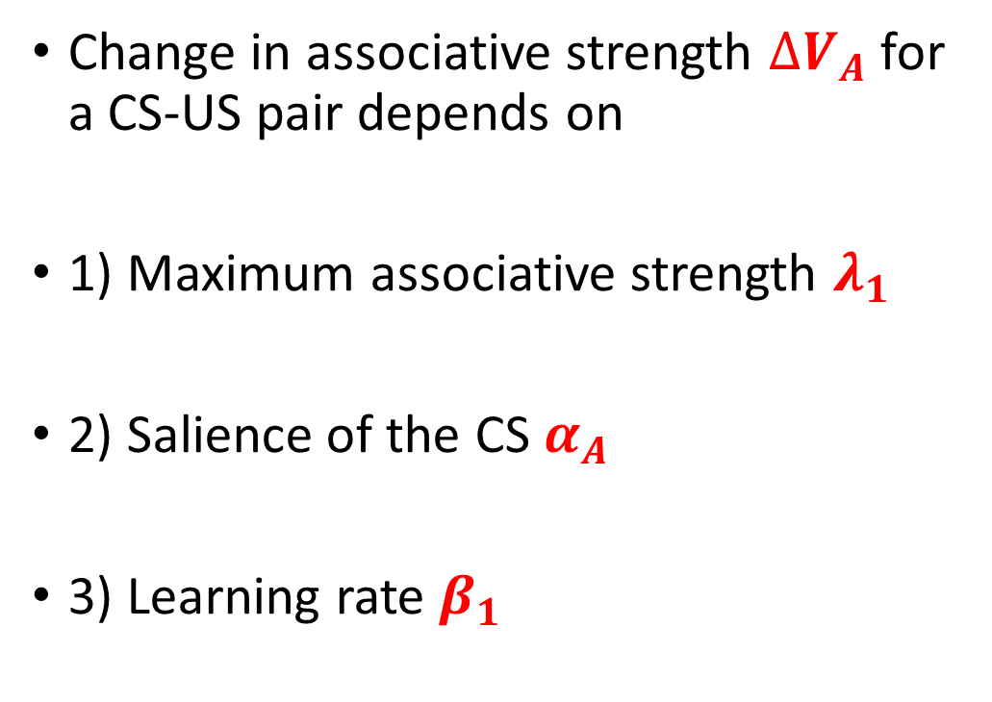
Recap: Rescorla-Wagner Theory Formalisation
Change in associative strength $∆V_{A}$ for a CS-US pair depends on
1) Maximum associative strength $λ_{1}$
2) Salience of the CS $α_{A}$
3) Learning rate $β_{1}$
Simple equation
$$∆V_{A}=α_{A}β_{1}\left(λ_{1}−V_{A}\right)$$
Prediction error
Psychological: surprise
Kamin interpretation

Slide 64
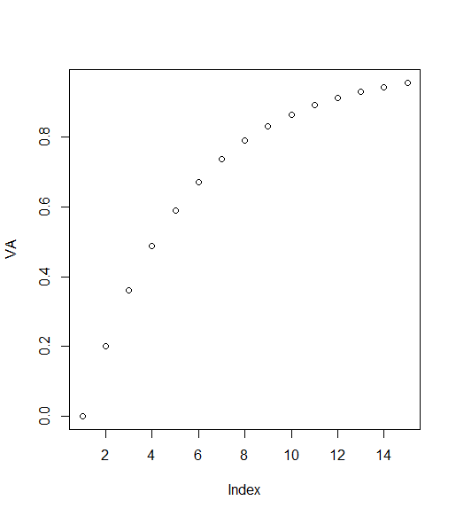
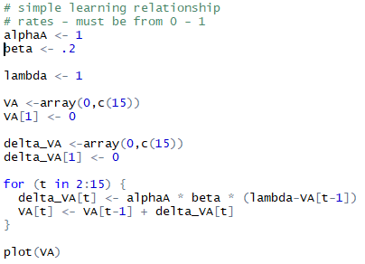
Recap: Rescorla-Wagner Simulation

Slide 65

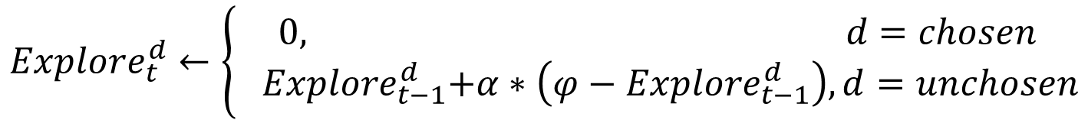
VSE – Sequential exploration
$$∆V_{A}=α_{A}β_{1}\left(λ_{1}−V_{A}\right)$$
$${Explore}_{t}^{d}←\left\{\begin{aligned}0, d=chosen \\ { Explore}_{t−1}^{d}+α∗\left(φ−{Explore}_{t−1}^{d}\right), d=unchosen\end{aligned}\right.$$

Slide 66
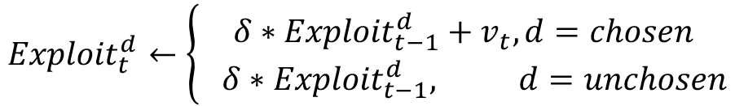


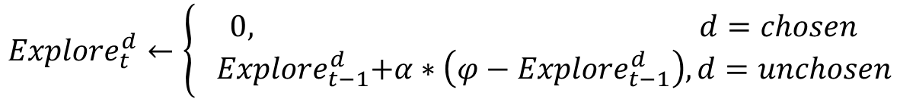
$$v\left(t\right)←{Gain(t−1)}^{θ}−{Loss(t−1)}^{θ}$$
$${Exploit}_{t}^{d}←\left\{\begin{aligned}{δ∗Exploit}_{t−1}^{d}+v_{t}, d=chosen \\ { δ∗Exploit}_{t−1}^{d}, d=unchosen\end{aligned}\right.$$
$${Explore}_{t}^{d}←\left\{\begin{aligned}0, d=chosen \\ { Explore}_{t−1}^{d}+α∗\left(φ−{Explore}_{t−1}^{d}\right), d=unchosen\end{aligned}\right.$$
$$p_{t}^{d}←\frac{e^{\left({Explore}^{d}+{Exploit}^{d}\right)∗C}}{\sum_{i=1}^{d}{e^{\left({Explore}^{i}+{Exploit}^{i}\right)∗C}}}$$
Free parameters
θ ~ Uniform(0,1) – Risk preference
δ ~ Uniform(0,1) – Value learning rate
a ~ Uniform(0,1) – Sequential exploration learning rate – build up of “urge”
ϕ ~ Normal(0,0.01) – (or unbounded) – asymptote for sequential exploration
C ~ Uniform(0,5) – (or 3^{β} – 1, β ~ Uniform(0,5) – Noise/random exploration

Slide 67
Three variations on bandit models
PVL-delta: Prospect Theory + Rescorla-Wagner framework (delta rule) + Luce Choice Rule
ORL: Value of outcomes + Frequency of outcomes + Perseverance with prior choice + Luce Choice Rule
VSE: Value of outcomes + Urge to explore alternatives + Luce Choice Rule

